Slide 1
Islam, Sheikh Rabiul, et al. "Infusing domain knowledge in AI-based" black box" models for better explainability with application in bankruptcy prediction." arXiv preprint arXiv:1905.11474 (2019).
Although ”black box” models such as Artificial Neural Networks, Support Vector Machines, and Ensemble Approaches continue to show superior performance in many disciplines, their adoption in the sensitive disciplines (e.g., finance, healthcare) is questionable due to the lack of interpretability and explainability of the model.
→ In this work, we demonstrate a way to collect and infuse domain knowledge into a "black box" model for bankruptcy prediction. Our understanding from the experiments reveals that infused domain knowledge makes the output from the black box model more interpretable and explainable.
Explainability: 머신러닝이나 딥러닝 시스템의 내부 매커니즘을 인간 용어로 설명할 수 있는 정도. 무슨 일이 일어나고 있는지
설명할 수 있는 능력.
Interpretability:시스템 내에서 원인과 결과를 관찰할 수 있는 정도. 입력 또는 알고리즘 파라미터의 변경에 따라 어떤 상황이
발생할지 예측할 수 있는 정도.
(출처: https://www.kdnuggets.com/2018/12/machine-learning-explainability-interpretability-ai.html)

Slide 2
Introduction
Black box models are frequently used in the financial area, particularly towards bankruptcy prediction. In particular, the main focus of bankruptcy prediction is to predict the probability that the customer will be in default or bankrupt in the near future.
→ According to literature reviews by Alaka et al. [15] and Bellovary et al. [22], six out of the top eight Bankruptcy Prediction Model (BPM) are Artificial Intelligence (AI) based.
A decision in the financial domain (e.g., credit approval, default prediction) needs to be more than a number— it needs to explain the reason behind the decision that makes sense to a human. Furthermore, when there are many explanatory variables, and some explanatory variables are complex, this further complicates the explainability.
→ Therefore, we particularly focus on the explainability of black box models using domain knowledge which falls into interpretability in the pre-modeling stage.

Slide 3
Introduction
We use a frequent pattern mining algorithm to find frequent feature sets used in different bankruptcy literature.
Later, we relate the frequent feature set with the popular financial concept of credit to come up with a generalized feature set for the experiments, which ultimately allows us to infuse domain knowledge to increase the explainability and interpretability of "black box" models.
the 5C’s of credit is commonly used to analyze key factors:
character (reputation of the borrower/firm), capital (leverage), capacity (volatility of the borrower’s earnings), collateral (pledged asset), cycle (macroeconomic)
In summary, our contributions in this work are as follows:
we demonstrate a way to collect and use domain knowledge from the literature
we introduce a way to bring popular concepts (e.g., the 5 C’s of credit) from literature to aid in interpretability and explainability
our experimental results show "black box" models can be better explainable with little or no compromise in performance when domain knowledge is infused.

Slide 4

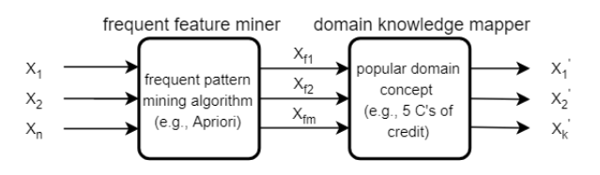
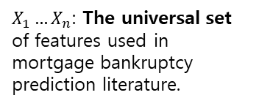
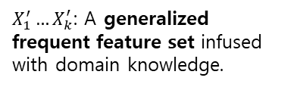
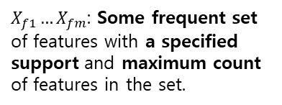
Methodology
The proposed approach consists of two components:
Feature generalizer: gives a generalized frequent feature set with the help of domain knowledge.
The frequent feature miner takes multiple different sets of features used in different bankruptcy prediction literature to discover the most frequent set of features (i.e., a frequent combination of features used in different literature) using a popular and classic frequent pattern mining algorithm called Apriori (Agrawal et al. [14]).
$X_{1}…X_{n}$: The universal set of features used in mortgage bankruptcy prediction literature.
$X_{f1}…X_{fm}$: Some frequent set of features with a specified support and maximum count of features in the set.
$X_{1}^{′}…X_{k}^{′}$: A generalized frequent feature set infused with domain knowledge.

Slide 5
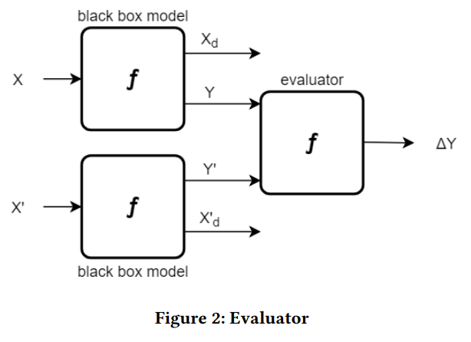
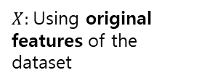

Methodology
Evaluator: produces and compares the results using the generalized feature set from the original feature set.
If the difference is within an allowable threshold, then the output from the latter experiment is deemed as final output, and the output is explained using the contribution from each of generalized, and more explainable and interpretable, frequent features.
$X:$Using original features of the dataset
$X^{′}$: Using the generalized frequent feature sets

Slide 6
Methodology
Algorithms
Apriori
For our case, when a set of features or explanatory variables found in a paper meets a user-specified support threshold, then that set of features can be treated as frequent feature sets.
Support (X) =
(number of paper in which all features of X appear) / (total number of paper)
EX) the support threshold is set to .5 (i.e., 50%), then the feature set LTV, creditScore, interestRate, delinquencyStatus is called a frequent feature set if and only if this set of features is found together at least 50% of times among all the papers.
2) Artificial Neural Network (ANN)
ANN was first used in 1994 by Wilson and Sharda [72] for bankruptcy prediction. In terms of different performance metrics, given enough data, ANN performs best for many problems due to its capability of learning any non-linear function.

Slide 7
Methodology
Algorithms
3) Support Vector Machine (SVM)
SVM is listed as one of the top nonlinear algorithms for bankruptcy prediction in different literature surveys [15, 22]. When the number of samples is too high (i.e., millions) then it is very costly in terms of computation time. In that case, a non-linear algorithm like ANN can be a better choice as an ANN usually works well with large datasets.
4) Random Forest (RF)
A Random Forest is a tree-based ensemble technique developed by Breiman et al. [27] for the supervised classification task. This results in a forest of trees being generated, and the output from all the trees are averaged for the final prediction. This averaging helps to reduce the variance from the model. Furthermore, RF can work in a parallel computing environment as trees can be grown independently. According to [34], RF has been used in different credit scoring and customer attrition applications.

Slide 8
Methodology
Algorithms
5) Extra Trees (ET)
Extremely Randomized Trees or Extra Trees (ET) is also a tree-based ensemble technique like RF. The only difference is in the process of splitting attribute selection and determining the threshold (cut- off ) value, both are chosen in extremely random fashion. As a result of multiple trees, the variance is reduced, compared to Decision Trees, however bias is introduced. The ET has continued its success by achieving the state of the art performance in some anomaly/intrusion detection research.
6) Gradient Boosting (GB)
Gradient Boosting (GB) is a classifier/regression model in the form of an ensemble of weak prediction models, such as Decision Trees which are fitted with data initially. It also works sequentially like the AdaBoost algorithm, in that each subsequent model tries to minimize the loss function (i.e., Mean Squared Error) by paying special focus on instances that were hard to get right in previous steps.

Slide 9
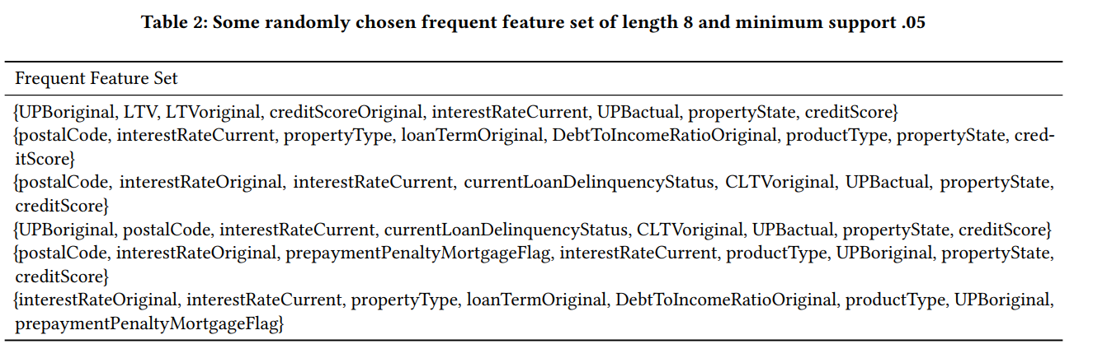
Data & Experiments
33 research papers related to mortgage bankruptcy prediction
The hyper-parameters for the frequent pattern mining algorithm (i.e., Apriori) are a minimum support threshold .05 and a maximum length 8. Maximum length refers to the maximum number of features that we want to see in any frequent feature set.

Slide 10
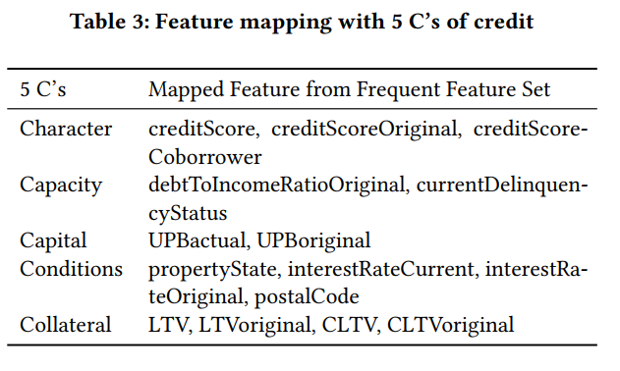
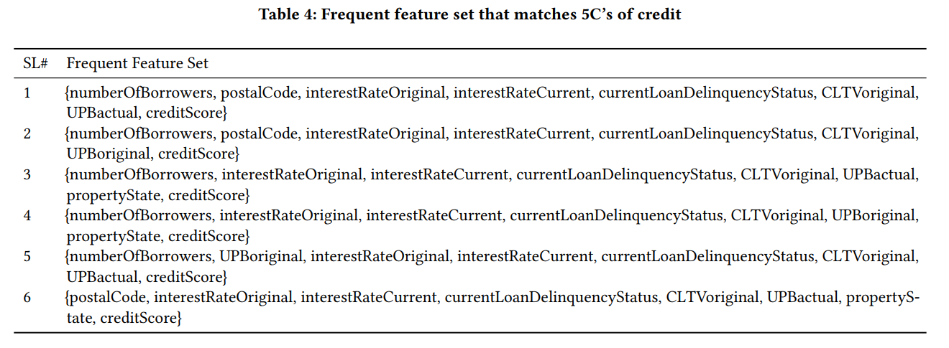
Data & Experiments
33 research papers related to mortgage bankruptcy prediction
Table 3 shows a mapping of the 5 C’s to relevant features based on the information from.
All feature sets that don’t contain at least one of the features from each category (each of the 5 C’s) is discarded. This gives us 25 feature sets where each of the feature sets contains at least one of the features under each C of the 5 C’s of credit.
(Table 4)

Slide 11
Data & Experiments
Freddie Mac single-family loan-level dataset(In the evaluator part)
Freddie Mac, a government-sponsored enterprise, is making available loan-level credit performance data on fixed-rate mortgages that the company purchased or guaranteed.
(Public available)
We took a stratified sample of the data which contains 113,130 records, out of which 198 of the records are default giving us a highly imbalanced dataset with only .18% (<1%) of target samples.
We use 70% of the data for training the models and kept 30% of the data as a holdout set to test the model. We make sure the target class has the same ratio in both the training and test sets.
We run the supervised algorithms in two different ways:
using original features: 30 selected features given by the feature selection algorithm
(2) using generalize frequent features set: we use each of the 25 generalized features sets separately for each algorithm. Each of the generalized feature sets consists of eight generalized feature based on the mapping from the domain knowledge.

Slide 12
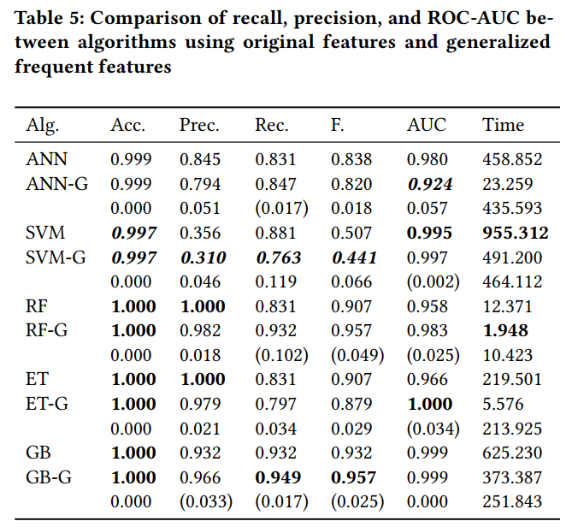
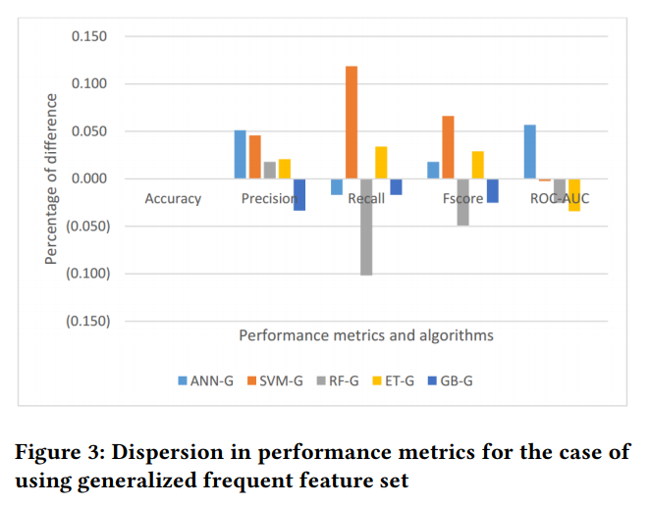
Data & Experiments
We found that using frequent feature set # 5 (see Table 4), out of the 25 generalized feature sets, for algorithms RF-G, ET-G, and GB-G we are able to achieve the best result based on performance metric recall. For ANN-G and SVM-G, pattern 3 and 6 worked better accordingly. Therefore, this helps to choose the best generalized frequent feature set for a particular algorithm among many generalized frequent feature sets.

Slide 13

Data & Experiments
One way is by expressing the output as a percentage of the total risk, and the segregation of the output value is the percentage that each of the generalized frequent features is liable. We can express the total risk probability with the following formula:
where g is the generalized frequent feature. Instead of using con- tributions from generalized frequent features, we can also express the output in terms of the contribution from each element of the domain concept. This might improve the interpretability a little bit at the expense of losing some details.

Slide 14
Conclusion
In this work, we demonstrated a way to collect and use domain knowledge from the literature. We also introduced a way to bring and infuse popular concepts (e.g., 5 C’s of credit) from the literature that aide in better interpretability and explainability. Our experimental results show that "black box" models can be better explainable without much compromise in performance when domain knowledge is infused.
In addition, incorporating other concepts as domain knowledge will verify its generality, making this approach transferable to other domains like cyber-security and healthcare.

